Slide 1
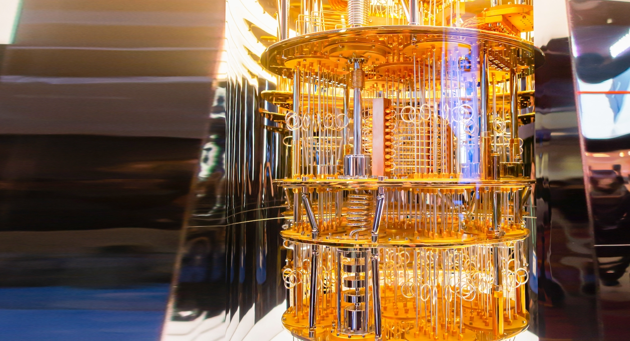
Quantum enhanced cross
chain arbitrage
with
Flare
Team EthumBards

Slide 2
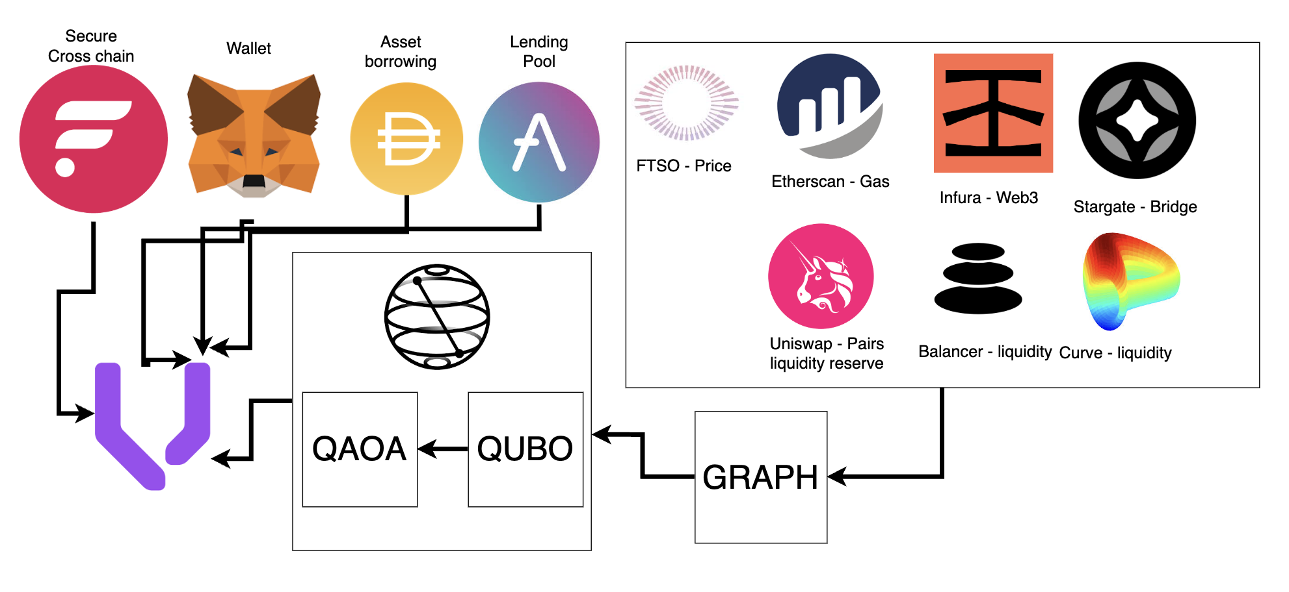

Slide 3
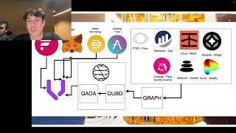
DEMO
Team EthumBards

Slide 4
Considerations
API Time
NISQ
Caching / dynamic programming esque

Slide 5
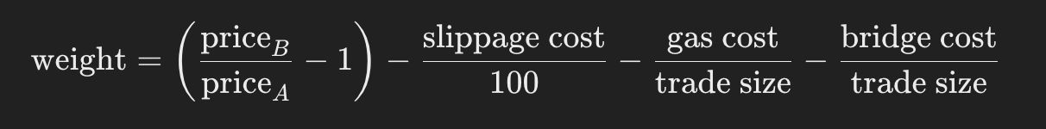
The Graph
Team EthumBards

Slide 6
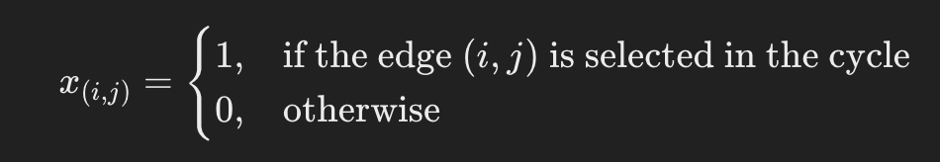
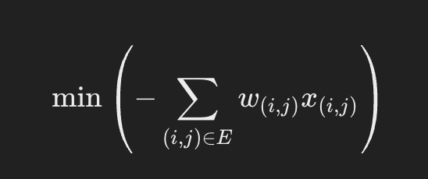
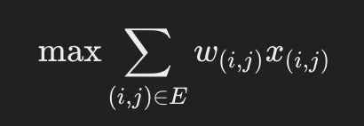
The QUBO
Team EthumBards

Slide 7
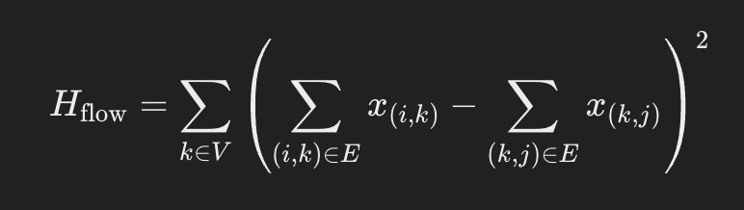
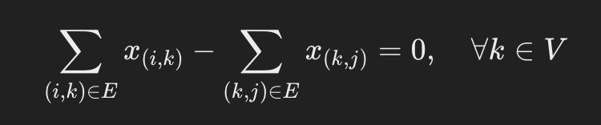
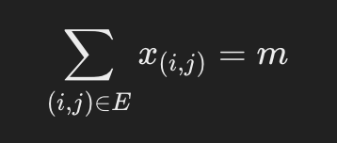
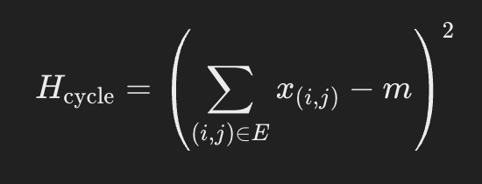
Forming a Hamiltonian
Team EthumBards

Slide 8
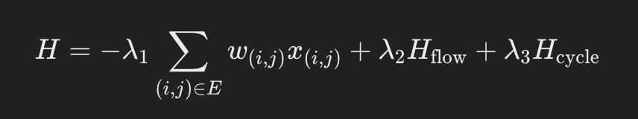
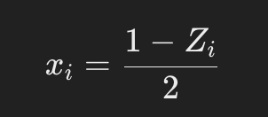
The Hamiltonian
Team EthumBards

Slide 9
Why Quantum?
Team EthumBards

Slide 10
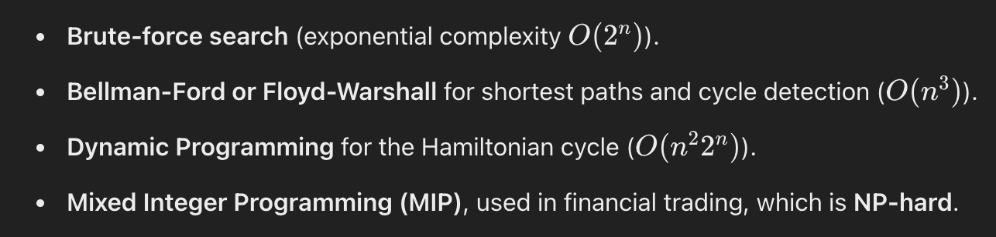
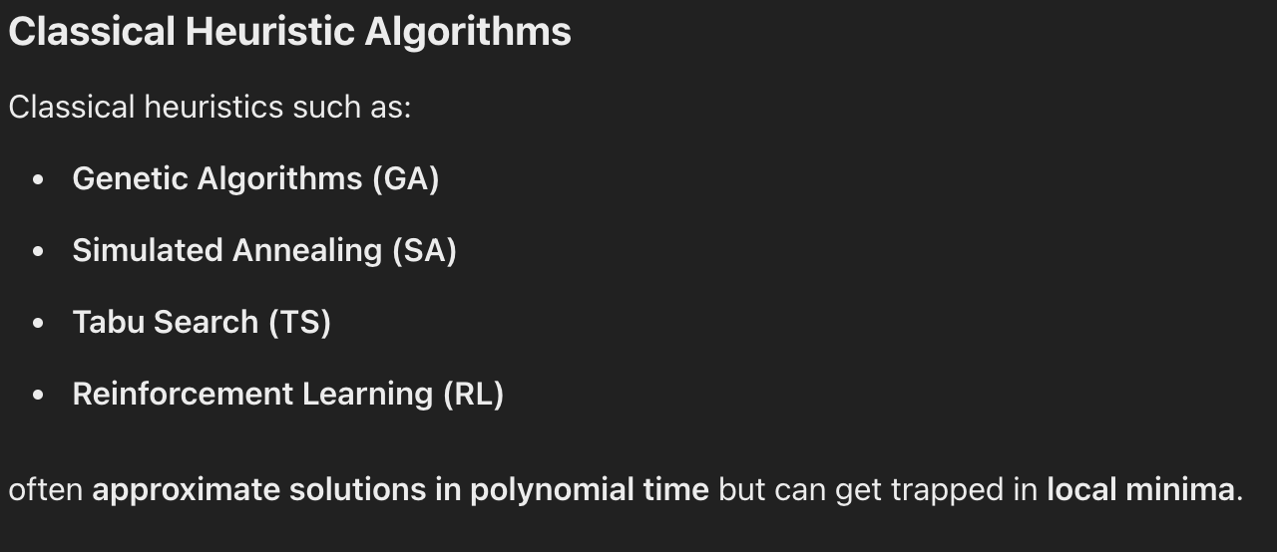
Team EthumBards

Slide 11
Team EthumBards

